Slide 1
Global Internet Usage
By Abhishek Gundala and Priya Gandhi

Slide 2
Introduction
The internet has emerged as one of the most crucial elements of modern society, to the extent that the mere thought of living without it is inconceivable. This highlights its significance in our lives and underscores the fundamental role it plays in shaping our daily experiences. However, despite its widespread usage, a substantial discrepancy exists in internet accessibility and usage across various regions and nations.
In our project, we have tried to understand how internet usage varies across different countries and what factors might influence this variation and to do so, we have used a comprehensive dataset on global internet usage with the following variables:
Country: Unique Identifier
Income per person: Gross Domestic Product per capita in constant 2000 US$ (referred as GDP)
Internet use rate: Internet users (per 100 people).
Urban rate: Percentage of urban population, that are living in urban areas as defined by national statistical offices

Slide 3
Project objective
This proposed research seeks to examine the worldwide utilization of the Internet and analyze its effects on economies and societies. Additionally, it aims to explore if there is any potential correlation between a country's population, GDP, and internet penetration rate.
Following are the research questions we propose to answer:
Which countries have the highest and lowest internet usage rates across the globe?
Is there a relationship between a country’s GDP and its internet penetration rate?
Does urbanization affect Internet usage patterns? Urban users v/s non-urban internet users in the country/continent

Slide 4
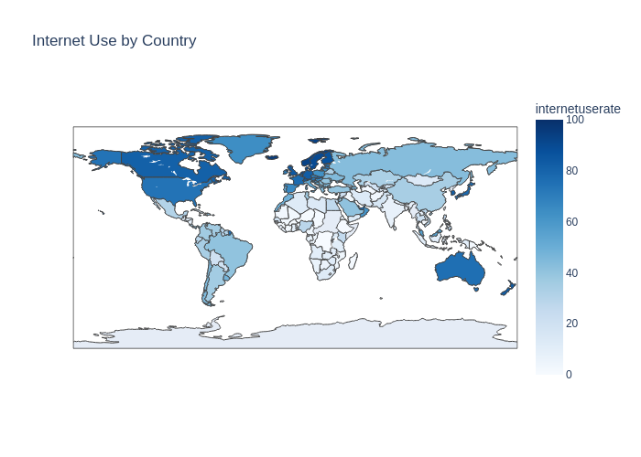
Internet usage by the Countries
Greenland has the highest internet usage (95.63%) and Timor-Leste has the lowest internet usage (0.21%)

Slide 5
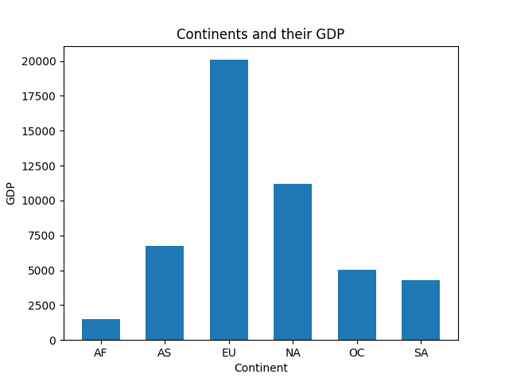
Average GDP per Continent

Slide 6
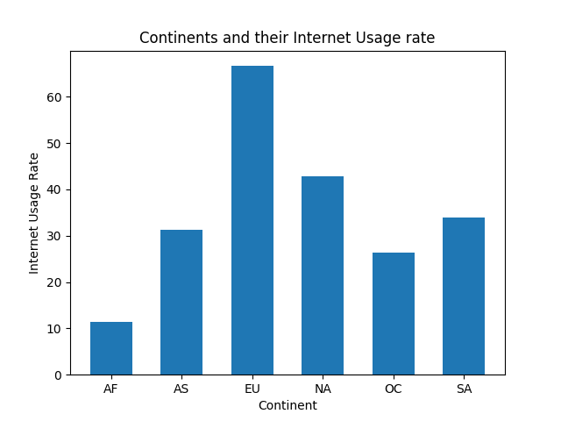
Average internet usage by each continent

Slide 7
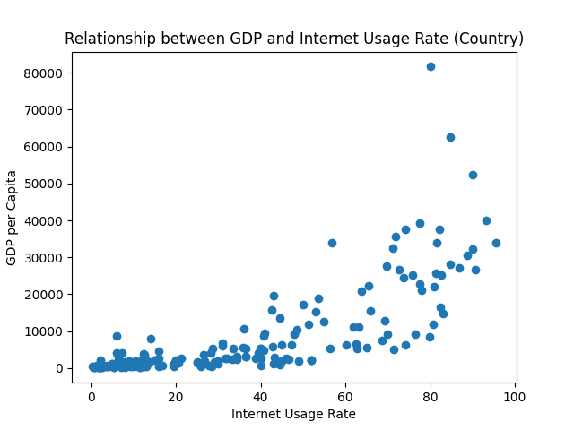
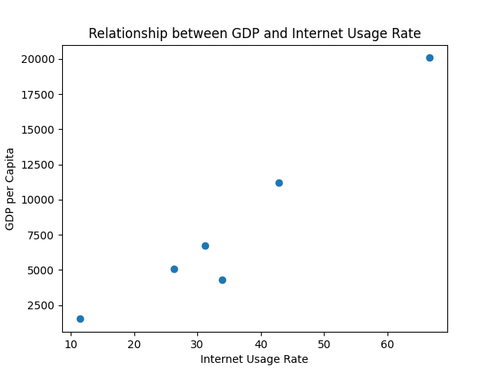
Is there a relationship between GDP and internet usage?

Slide 8
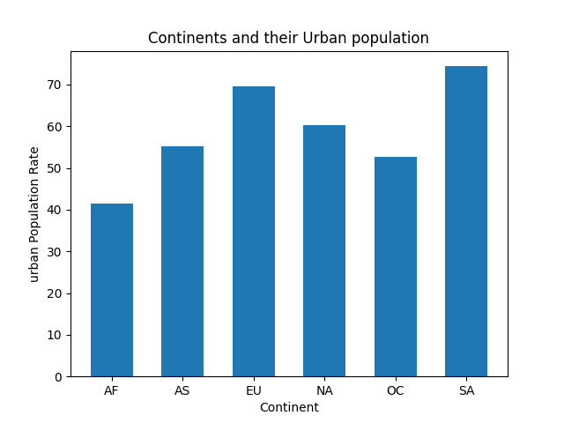
Continents and their urban population

Slide 9
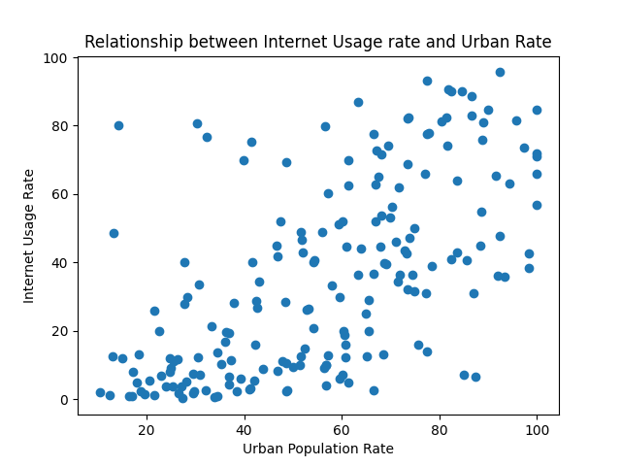
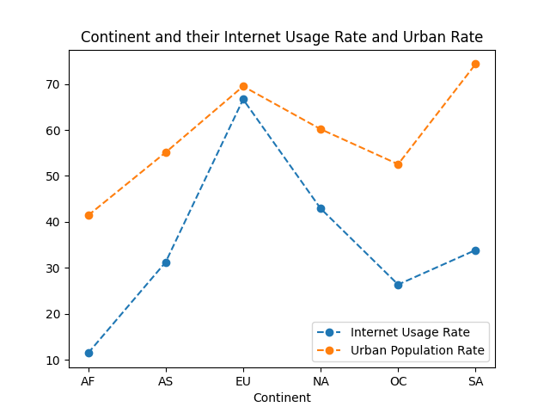
Relationship between Urbanisation and Internet usage rate

Slide 10
Conclusion
The rate of internet usage varies greatly among different countries, ranging from as low as 0.21% to as high as 95.63%.
There are lot of factors that influence the internet usage rate. With the help of this dataset, we can conclude that GDP and urban rate has a positive relation with the internet usage rate. There are likely to be many factors that influence internet usage, but these two variables are particularly important
It's worth noting that there may be several other factors that can exert a significant impact
Understanding the impact of various factors can help to comprehend a country's progress towards technological advancement, financial development, and other related areas

Slide 11
Reference
Tools Used
https://www.kaggle.com/datasets/sansuthi/gapminder-internet
Python

